Slide 1
Entitlements of Libraries, Archieves and Museums - Looking Through the Copyright Lens
Prof. Prabuddha Ganguli
&
S. Matilal

Slide 2
Why Copyright Relevant?
First: Libraries, Archieves and Museums cater to the needs of the Consumers of Copyright
They procure books, journals, use data bases, digital content, provide photocopying services.
These contents are used by researchers, students and general public.
Second: Libraries produce of Copyrighted Content (Library Publishing)
They scholarly monographs, books, conference proceedings, old photographs etc.

Slide 3
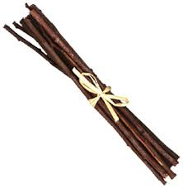
What is Copyright?
Real Property
R1, R2, R3, R4, …….. Rn
Possess
Use
Enjoy
Transfer (Sell)
Encumber
Doing Nothing
Destroy
Residuary Rights
To reproduce the work in any material form
To issue copies of the work to the public
To perform the work in public
To communicate the work to the public
To make any cinematograph film or sound recording in respect of the work
To make any translation of the work
To make any adaptation of the work

Slide 4
What is Infringement? Violation of any of the Rights
For example photocopying of a book violates right to reproduction.
Scanning of a book violates right to reproduction.
Sending the scanned book through email violates right to circulation.

Slide 5
How to Escape Infringement?
Take License.
Or
Ensure that the activities fall within the ambit of exceptions, the major of which is fair dealing/fair use.

Slide 6
Fair use vs. fair dealing

Slide 7
How Fair Use/Fair Dealing provision may be casted in a copyright statute?
Standard Based Approach: It can be done in the form of laying down broad-based standards vesting discretion upon the courts to decide what uses are fair. Example U.S.
Rule Based Approach: The other approach is laying down well defined bright-line rules, indicating the precise situations that constitute fair use. Normally, this kind of casting requires meticulous detailing of the circumstances that may qualify as fair use. Example India

Slide 8
Ex Post Determination by the Court (Risk of Uncertainty)
There always exists the uncertainty that the copyright holder may not concur with the fair use interpretation of the user claiming non-infringement.
Ultimately, the dispute may have to be resolved by a litigation. If the court finds that the use is not a fair use, then the user would be treated as infringer and he/she may have to pay damage to the copyright owner.

Slide 9
STANDARD BASED APPROACH
THE U.S. PARADIGM

Slide 10
Section 107 of the U.S. Copyright Act, 1976 Limitations on exclusive rights: Fair use
Notwithstanding the provisions of sections 106 and 106A, the fair use of a copyrighted work, including such use by reproduction in copies or phonorecords or by any other means specified by that section, for purposes such as criticism, comment, news reporting, teaching (including multiple copies for classroom use), scholarship, or research, is not an infringement of copyright. In determining whether the use made of a work in any particular case is a fair use the factors to be considered shall include—
(1) the purpose and character of the use, including whether such use is of a commercial nature or is for nonprofit educational purposes;
(2) the nature of the copyrighted work;
(3) the amount and substantiality of the portion used in relation to the copyrighted work as a whole; and
(4) the effect of the use upon the potential market for or value of the copyrighted work.
The fact that a work is unpublished shall not itself bar a finding of fair use if such finding is made upon consideration of all the above factors.

Slide 11
Purposes such as (not exhaustive)
Criticism
Comment
News reporting
Teaching (including multiple copies for classroom use)
Scholarship
Research

Slide 12
The four factors that the U.S. courts take into account in determining fair use
Purpose and character of use
Nature of the copyrighted work
Amount and substantiality of the portion taken
The effect of the use upon the potential market

Slide 13
BRIGHT LINE RULE BASED APPROACH
THE INDIAN PARADIGM

Slide 14
Fair Dealing
Section 52 of the Copyright Act, 1957 contains elaborate list of cases that do not constitute infringement. For instance Section 52(1)(a) contemplates that the following acts shall not constitute an infringement of copyright:
“a fair dealing with any work, not being a computer programme, for the purposes of-
(i) private or personal use, including research;
(ii) criticism or review, whether of that work or of any other work;
(iii) the reporting of current events and current affairs, including the reporting of a lecture delivered in public.
Explanation.-The storing of any work in any electronic medium for the purposes mentioned in this clause, including the incidental storage of any computer programme which is not itself an infringing copy for the
said purposes, shall not constitute infringement of copyright"

Slide 15
Hubbard v Vosper, [1972] 2 Q.B. 84
The Indian understanding of fair dealing to a great extent is being influenced by the English developments. In the leading English case of Hubbard v Vosper (cited by the Indian Court), while dealing with the copyright infringement allegation by the Church of Scientology against one of its former members, Vosper, (who criticized Scientology in his book The Mind Benders) Lord Denning observed:
“It is impossible to define what is "fair dealing." It must be a question of degree. You must consider first the number and extent of the quotations and extracts. Are they altogether too many and too long to be fair? Then you must consider the use made of them. If they are used as a basis for comment, criticism or review, that may be fair dealing. If they are used to convey the same information as the author, for a rival purpose, that may be unfair. Next, you must consider the proportions. To take long extracts and attach short comments may be unfair. But, short extracts and long comments may be fair. Other considerations may come to mind also. But, after all is said and done, it must be a matter of impression. As with fair comment in the law of libel, so with fair dealing in the law of copyright. The tribunal of fact must decide. In the present case, there is material on which the tribunal of fact could find this to be fair dealing”

Slide 16
Fair Dealing Cases
In Chancellor, Masters and Scholars of University of Oxford v. Narender Publishing House [2008 (38) PTC 385 (Del)], guide books that solved all the problems of the mathematics book of the plaintiff, was held to be fair dealing. Though the guide books copied all the problems of the mathematics book, but the Court found the same to be transformative.
In Super Cassettes Industries v. Hamar Television Network Pvt. Ltd. [2011 (45) PTC 70 (Del)], the plaintiff music company sought injunction against a Bhojpuri TV channel which was broadcasting its copyrighted works. The Court decided in favour of the plaintiff. The Court also took the opportunity to summarize the law of fair dealing.

Slide 17
LIBRARY EXCEPTIONS

Slide 18
Library Exception 1
Section 52(1)(n) the storing of a work in any medium by electronic means by a noncommercial public library, for preservation if the library already possesses a non-digital copy of the work.
Example: Your Library has a hard copy of Amish Tripathi’s Latest Book “RAAVAN- Enemy of Aryavarta”. You can scan and store the book for archival purpose.

Slide 19
Library Exception 2
S52(1)(o) the making of not more than three copies of a book (including a pamphlet, sheet of music, map, chart or plan) by or under the direction of the person in charge of a non-commercial public library public library for the use of the library if such book is not available for sale in India.

Slide 20
Library Exception 3
S 52 (1) (p) the reproduction, for the purpose of research or private study or with a view to publication, of an unpublished literary, dramatic or musical work kept in a library, museum or other institution to which the public has access.
This is available to any library whether commercial or non-commercial.
Example: Your library possesses an unpublished copy of music composed by Mozart. You may publish the same.

Slide 21
The Problem of Non-Commercial Public Library
Section 2(fa) of our Copyright Act defines “non-profit library” in the context rental of computer programme, sound recording, visual recording and cinematograph. It contemplates that rental by a “non-profit library” should not be treated as “commercial rental” which is otherwise is one of the exclusive rights of the copyright-holder under Sections 14(b)(ii), 14(d)(ii) and 14(e)(ii).
This has nothing to do with the fair dealing (library exception) provisions of Sections 52(1)(n) and 52(1)(o). Moreover, these two sections use the expression “noncommercial public library” whereas Section 2(fa) deals with the expression “non-profit library.” They are not one and the same.

Slide 22
Issues at a glance

Slide 23
CAN YOUR USERs Use the Library’s Photocopier or scanner?

Slide 24
Library users often seek to make copies of library-owned materials.
Here the question is whether the user is copying something which has fallen in public domain, if the answer is “YES” the matter ends there. If the answer is “NO” we need to check as to whether the activities of the user comes under “fair dealing” for “private or personal use including research.” Transformative? Primary and Secondary Market? Hubbard v Vosper formula?
If the individual user becomes primarily liable the library may also became liable under secondary theories of infringement.
Caution: University of New South Wales v Moorhouse, [1976] RPC 151

Slide 25
WHEN Materials are made Available on-line by the Library

Slide 26
At times libraries make digitized copies of copyrighted materials to make them available to the public at large.
If those materials are copyright protected, then the library must take appropriate public measures.

Slide 27
Use of the RightsStatements
Notices
1) Unless expressly stated otherwise, the organization that has made this Item available makes no warranties about the Item and cannot guarantee the accuracy of this Rights Statement. You are responsible for your own use.
2) You may find additional information about the copyright status of the Item on the website of the organization that has made the Item available.
3) You may need to obtain other permissions for your intended use. For example, other rights such as publicity, privacy or moral rights may limit how you may use the material.
This Item is protected by copyright and/or related rights. You are free to use this Item in any way that is permitted by the copyright and related rights legislation that applies to your use. For other uses you need to obtain permission from the rights-holder(s).

Slide 28
Points to Take into Consideration
RightsStatements is not used for mass-scale produced copyrighted content.
Library allocates the risk to the user.

Slide 29
Library users requesting librarians to make photocopy

Slide 30
The point here is that the user himself/herself is not copying rather he/she asking the library to do photocopying for him/ her.
If act had been done personally by him/her whether the same would have been fair dealing?

Slide 31
Creating Course Packs for Students

Slide 32
U.S.A: Princeton University Press v. Michigan Document Services, Inc. [Not fair use]
India: The Chancellor, Masters & Scholars of the University of Oxford & Ors. v. Rameshwari Photocopy Services & Ors. [Fair Dealing]

Slide 33
Inter-Library Loans

Slide 34
No express provision in India.
First Sale doctrine?

Slide 35
THe Issue of orphan works

Slide 36
Section 31A
Where, in the case of any unpublished work or any work published or communicated to the public and the work is withheld from the public in India, the author is dead or unknown or cannot be traced, or the owner of the copyright in such work cannot be found, any person may apply to the Appellate Board for a licence to publish or communicate to the public such work or a translation thereof in any language.

Slide 37
RightsStatements
This Item is protected by copyright and/or related rights. However, for this Item, either (a) no rights-holder(s) have been identified or (b) one or more rights-holder(s) have been identified but none have been located. You are free to use this Item in any way that is permitted by the copyright and related rights legislation that applies to your use.

Slide 38
IS METADATA COPYRIGHTABLE?

Slide 39
Policy Statement on Metadata of Digital Public Library of America (DPLA)
01. The Vast Majority of Metadata is Not Subject to Copyright Restrictions.
The DPLA believes that the vast majority of metadata is not subject to copyright, because it either expresses only objective facts (which are not original) or constitutes expression so limited by the number of ways the underlying ideas can be expressed that such expression has merged with those ideas.
DPLA is located at the Berkman Center for Internet and Society at Harvard Law School, therefore this statement carries a fair amount of legal credibility.

Slide 40
Twofold Questions
Is Metadata Original?
Is Metadata mere assembly of fact? Or by reason of originality of selection or arrangement it qualifies to copyrightable category?

Slide 41
Requirement of Copyright
Trinity of Copyright
Originality
Expression Not Idea/Fact/Functionality
Fixation

Slide 42
Originality Requirement
Copyright Law in India contemplates that copyright subsists in original Literary, Dramatic, Musical and Artistic Work

Slide 43
Originality
Meaning
Non-Copying (Independent Creation/ Must be authored)
Threshold
of Varied Degrees

Slide 44
Sheldon v. Metro-Goldwin Picture Co., 89 F2d 49, 54 (2d Cir. 1936) aff'd 309 US 390 (1940)
Judge Learned Hand had explained the concept in the following words:
“[I]f by some magic a man who had never known it were to compose anew Keats’s Ode on a Grecian Urn, he would be an author, if he copyrighted it, others might not copy that poem, though they might of course copy Keats’s”.

Slide 45
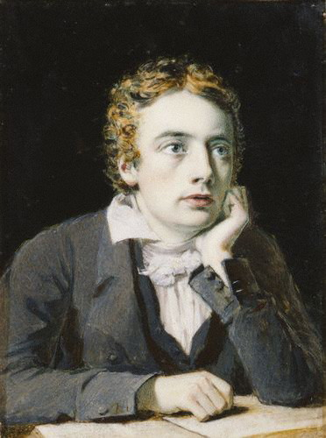
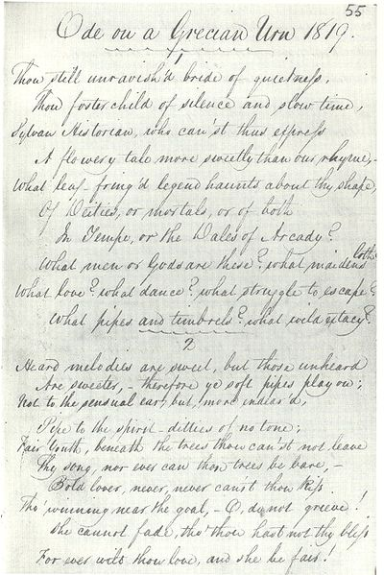
John Keats’s “Ode on a Grecian Urn”

Slide 46
Different Standards of Originality
Modicum of Creativity
Non-Trivial, Non-Mechanical Skill and Judgement
Sweat of the Brow

Slide 47
Indian Approach to Originality
In Eastern Book Company v. D.B. Modak [(2008) 1 SCC 1], our Supreme Court referring to the Canadian Supreme Court’s decision in CCH Canadian v. Law Society of Upper Canada adopted the following approach:
Copyright protects the original expression not the idea
The expression must originate from the author
For producing the work the author needs to apply labor, skill and judgment with a flavor of creativity.

Slide 48
Indian Scenario
Case 1: Mere compilation may not be, but if non-trivial and non-mechanical application labour, skill and judgment is present it may qualify for copyright protection.
Case 2: Before making any addition or alteration to others “copyrighted metadata” seek derivative license.

