Slide 1
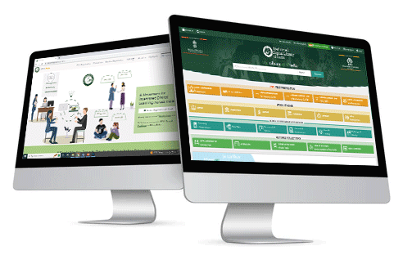
National Digital Library of India (NDLI)-
Phase III
National Digital Library of India & NDLI Club
One Library All of India
Please visit to access NDLI: https://ndl.iitkgp.ac.in or https://www.ndl.gov.in

Slide 2
What is NDLI?
A 24X7-enabled Digital Library
A Single window search/browse facility
Covers all academic levels (KG to PG) and disciplines
Collection-wise organization: School, Career Development, Law, Medical, etc.
Hosts multimedia contents: Text, Video, Audio, Image, Simulation, Animation, etc.
User Interface language:
Other than English it is also available in Hindi, Bangla, Gujarati, Marathi, Tamil, Kannada, Odiya, Telugu, Malayalam and Assamese
It is for: Schools, Colleges, Universities, R&D Institutions, Individual Learners, Life-long Learners

Slide 3
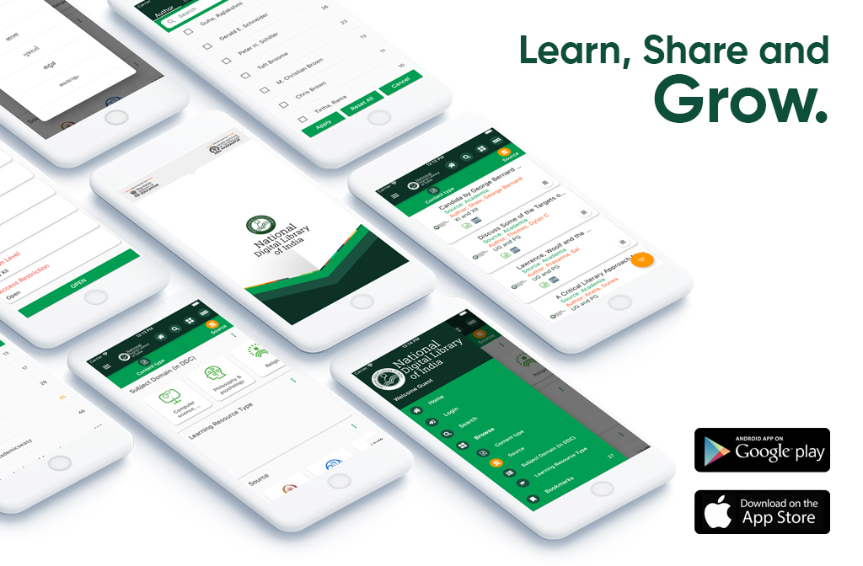
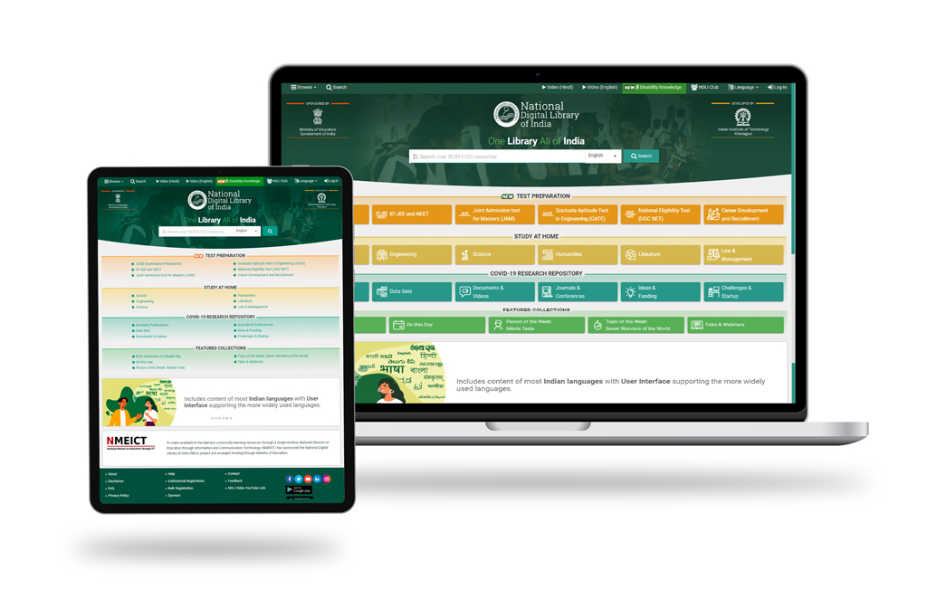
NDLI: The Library
Web App
(https://ndl.iitkgp.ac.in or www.ndl.gov.in)
Mobile App
(Google™ PlayStore)

Slide 4
Why NDLI
Lack of additional physical infrastructure for stacking resources.
Reduction in financial and human resources for libraries.
Accessing the same resources by multiple persons at the same time.
Missing/ hidden/ damaged resources.
Democratize the education system.

Slide 5
A Glimpse at the NDLI Repository
Total Contents: 9.8 Cr.+; out of them Open Access Contents: 8 Cr.+, NDLI Licenced Contents: 6.5 Lakh and Partner Sources: 600+
Contents available in 39 Indian languages out of 423 languages in NDLI
Helping school students in their studies by hosting content from 21 Indian school boards (12 more are in the process of integration)
NDLI offers open access to a huge collection of study materials for school students to help in their Study At Home
NDLI offers Search Facilities in 3 languages (more to be added) and User Interface in 11 languages
Built using open architecture, open source software & open metadata
User personalization: Filtering & ranking of search results as per user profile
Conducts engagement programs to raise awareness about the NDLI & its resources (free Workshops, Training Sessions, Talks & Webinars) 31 IDR workshop conducted covering all states and trained 2000
Provides facility to Institutions to disseminate open access content through its free Institutional Digital Repository (IDR) service
Set-up 4800+ NDLI Clubs & 150+ IDR remotely in different states.
Dedicated Examination Preparation Vertical
Dedicated CAREER Preparation Vertical
NDLI
Club
6
International Recognitions

Slide 6
NDLI - At a Glance
Reaching physical targets set by Ministry on contents consistently maintaining data quality & timeline.
Developing quality content using NDLI own resources for Examination & Career verticals like
✪ JEE Main & Advance ✪ NEET ✪ Railway Recruitment Board ✪ IBPS ✪ SSC ✪ UPSC CDS …
Introducing Digital Library at Raj Bhavan,Telangana portal as a Pilot initiative
Support installing IDRs (Institutional Data Repository) at all Universities, Institutes & integration to NDLI.
Setting up NDLI Club in all Schools, Universities & Institutes throughout the Country.
Outreach NDLI content to all corners of the country through NDLI Club & Social media platforms.
Improve data search facilities at the NDLI portal.
Developing automation in metadata creation & curation.
InterLibrary Loan (ILL) System - pilot phase is ready for implementation

Slide 7
Targets & Achievements
Reaching physical targets set by Ministry on contents consistently maintaining data quality & timeline.
Targets Timelines & Deliverables ( Content / Resources) in Million
FY |  |  | 2021-22 | 2022-23 | 2023-24 | 2024-25 | 2025-26
Target (Yearly) |  |  | 13 | 14 | 15 | 16 | 17
Target (Cumulative) at the end of FY |  |  | 73 | 87 | 102 | 118 | 135
Actual Achievements in Million
FY | 2021-22 | 2022-23 | 2023-24 (Q1)
Actual Production | 14.6 | 13.9 | 4.7

Slide 8
Users
NDLI Architecture: High Level
7.9 M+
Multi-lingual user interface and search
Vertical specific services for school, college
Verticals (School, College, Exam)
One Live Setup (@ Kharagpur) 85 Servers
Search & Browse (Multi-lingual)
Disaster Recovery Setup (Kolkata)
Services
NDLI
Repository
UMANG
Contributing Institutions
Harvester
Curation Pipeline
Ingestion
Integration
API
Third-Party Developers
497
Controlled Access
2
Outreach
Rich Metadata Standard (Followed by DLs in India)
Semi-automated workflow
User Engagement
Institution-level clubs: 4445 +
Partner in reading month
Engagement with teacher community
NDLI Club
11.5L+
Participating User

Slide 9
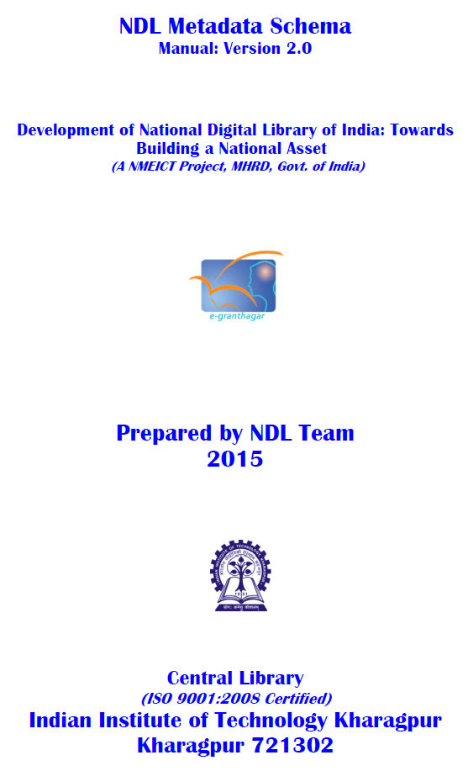
NDLI Metadata Schema
title
type
subject
language
Typical LT
description
Prerequisite Topic
Dublin Core
date
(generic)
author
LRMI
Pedagogic Objective
(educational)
NDLI Metadata
Education Level
researcher
department
keyword
Shodhganga
institution
advisor
(thesis)
awarded
place

Slide 10
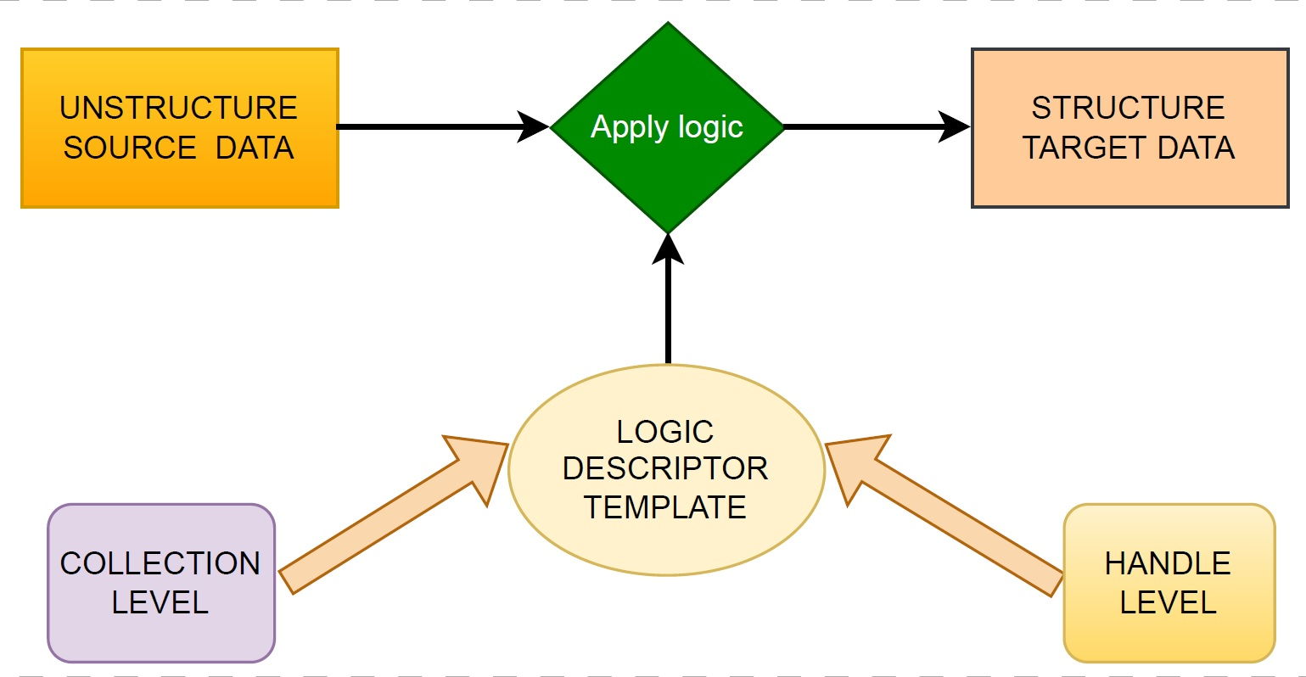
High-Level Architecture of Semi-automated Metadata Curation

Slide 11
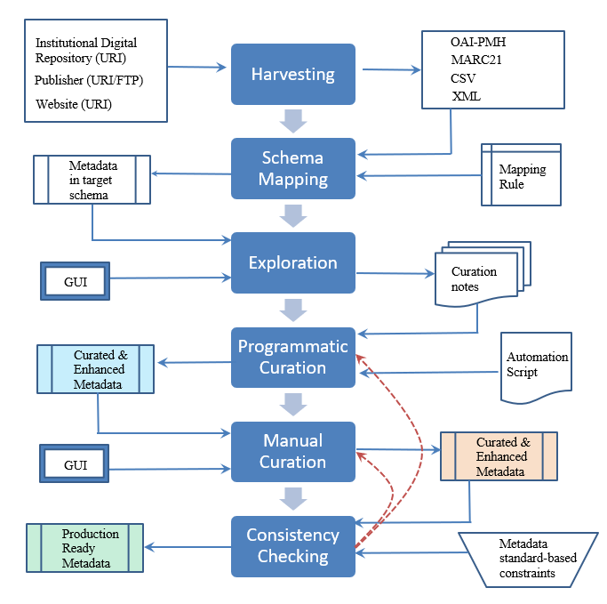
Semi-automated Metadata Curation Pipeline
(Patent Applied)
Productivity gain: Human productivity in terms of metadata curation has increased 10+ times facilitating content ingestion in large scale
Notes:
To be updated by PPD
IIT-KGP/NDLI was a forerunner in visualizing the Digital Ecosystem
NDLI was conceptualized on openness and inclusiveness and thus could transform and ensure continuation of learning during pandemic
IIT KGP/NDLI was ahead in conceiving NEP points

Slide 12
Data Curation Cycle
Start
Reject Source
Data Team Roles
MoU Templates
Data Entry & Curation Utilities
Metadata Specification
Data Source Issue Tracker
Acquisition System
Data Test Portal
Manual Curation Portal
User QA Instructions
LIVE Data Count Tracking Sheet
No
Source Identification
Source meets NDLI prerequisites
Pre-acquisition Data Analysis
Yes
Data Acquisition
Ingestion in test Portal
Data Analysis
Programmatic Curation
No
QA Validation
Yes
LIVE Ingestion
Programmatic Curation Validation
End
Manual Curation
QA Checking
No
Yes

Slide 13
General Application Across Sources
Metadata fields curation (Example- dc.contributor.author, dc.identifier.other@lccn, ndl.sourceMeta.additionalInfo@note, dc.description, ndl.sourceMeta.additionalInfo@references etc.).
Source value normalization for conforming to metadata standards. (E.g., dc.title, dc.description.abstract)
Fields add with the respective values.
Fields delete with the respective values.
With the help of this tool CSV files generate when we have required.
HID Script Generate & Syntactical Error checking
Content Stitching
Curation templates captures the steps and details of a curation round.

Slide 14
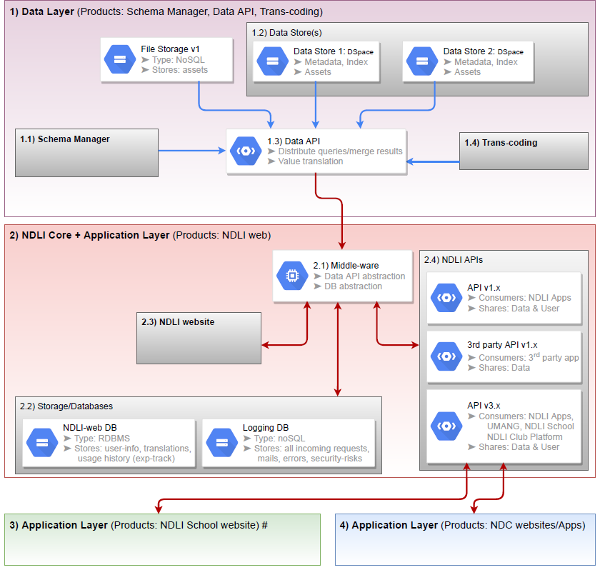
Hardware
NDLI has 85 Servers
Live System Architecture
Scalable and fault-tolerant design
Designed to support 10K concurrent connections
Layered architecture to ensure security
Content store size: 25TB
Notes:
To be updated by PPD
IIT-KGP/NDLI was a forerunner in visualizing the Digital Ecosystem
NDLI was conceptualized on openness and inclusiveness and thus could transform and ensure continuation of learning during pandemic
IIT KGP/NDLI was ahead in conceiving NEP points

Slide 15
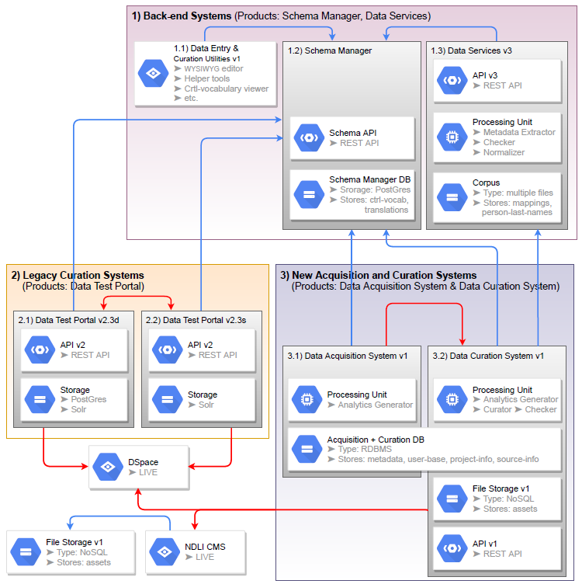
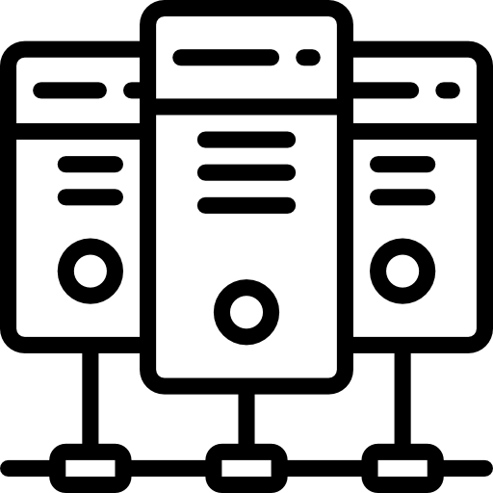
Back-Office Architecture
Tools Developed:
Data acquisition system
Data entry and curation utilities
Data test portal
Metadata schema manager
Syntactic error analyzer
Notes:
To be updated by PPD
IIT-KGP/NDLI was a forerunner in visualizing the Digital Ecosystem
NDLI was conceptualized on openness and inclusiveness and thus could transform and ensure continuation of learning during pandemic
IIT KGP/NDLI was ahead in conceiving NEP points

Slide 16
Vertical-oriented Content View Service

Slide 17
User Models

Slide 18
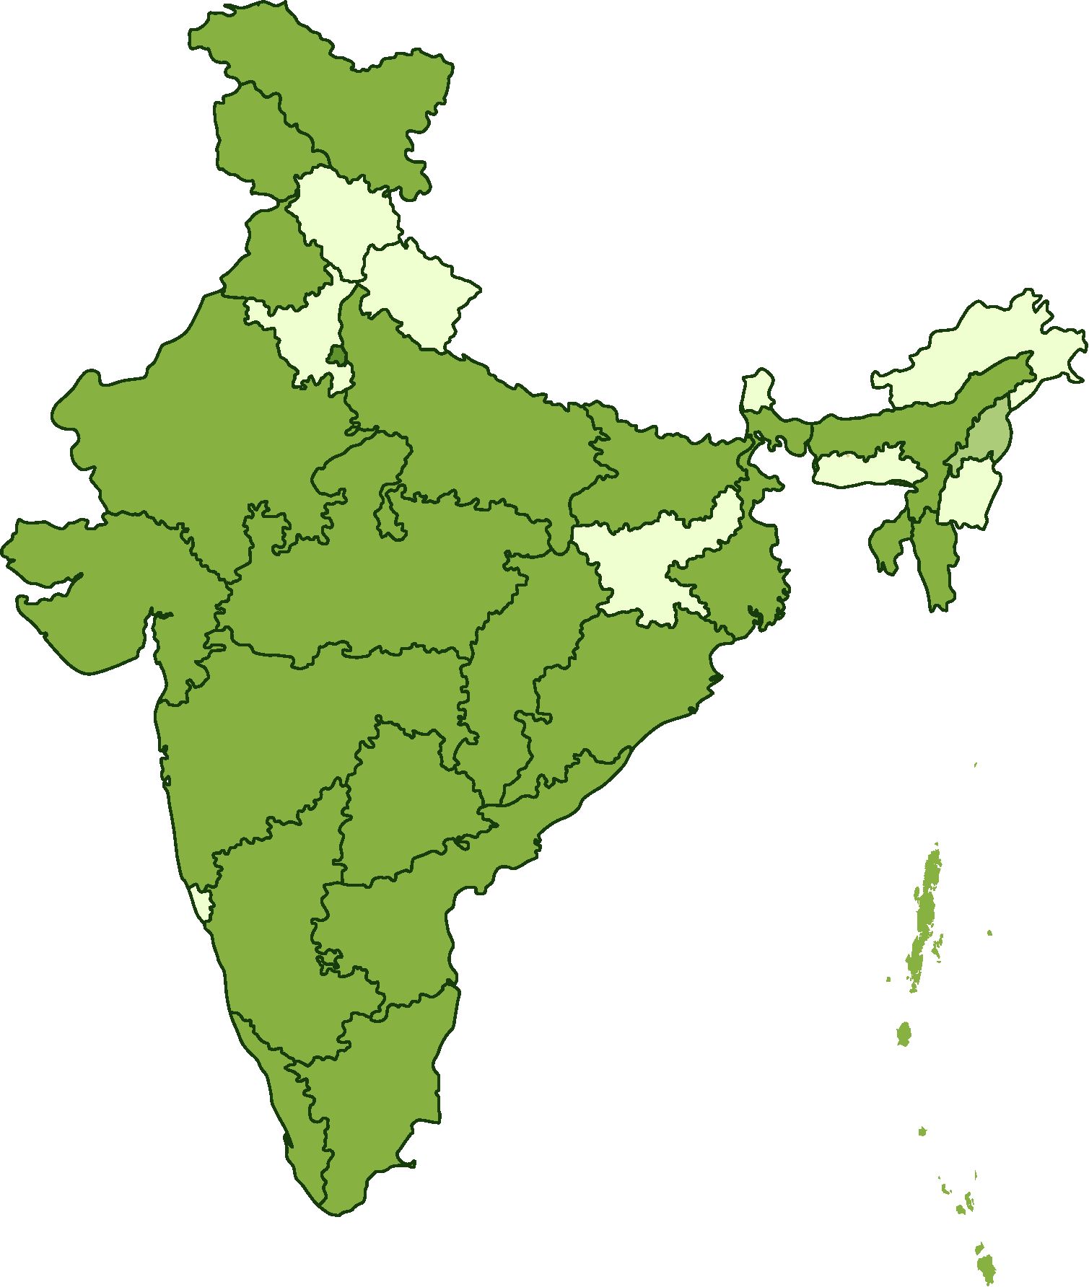
Featured Contents
(Children and Adolescents)
Government Bodies:
CBSE, NCERT, IIT-Professor Assisted Learning (IIT-PAL), Raj-eGyan, SCERT Telengana, SCERT Andhra Pradesh, SCERT Kerala etc.
Kendriya Vidyalayas (KVs):
Kendriya Vidyalaya ASC Centre(S), Bengaluru; KV-IFFCO, Gandhidham Library; Kendriya Vidyalaya Sangathan Agra Region, Kendriya Vidyalaya Sangathan etc.
Non-Government Organizations:
Alyss Edusolutions, cK-12, ComPADRE - Resources and Services for Physics Education, ExamFear, Science Kids, Khan Academy, Jagran Josh, Learn CBSE, Lit2Go Educational Technology Clearinghouse, s2s Classes, StemEZ etc.
Examination Vertical:
NDLI Tutor: JEE Advanced, JEE Main, NEET
Career Vertical:
NDLI Tutor: IBPS, RRB, SSC, UPSC etc.
Integrated State
School Boards (21 nos)
To be Integrated State School Boards (12 nos)

Slide 19
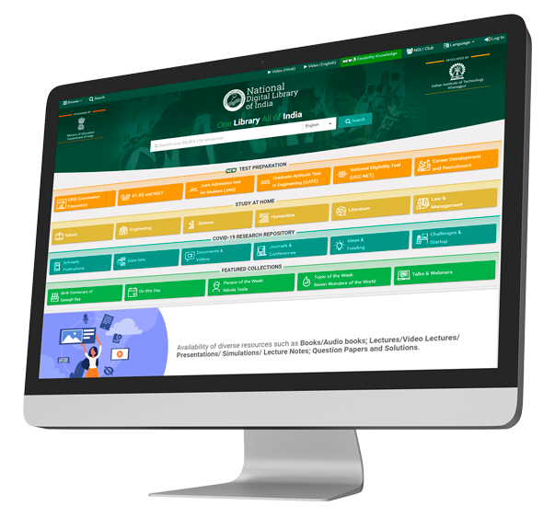
How to Search NDLI

Slide 20
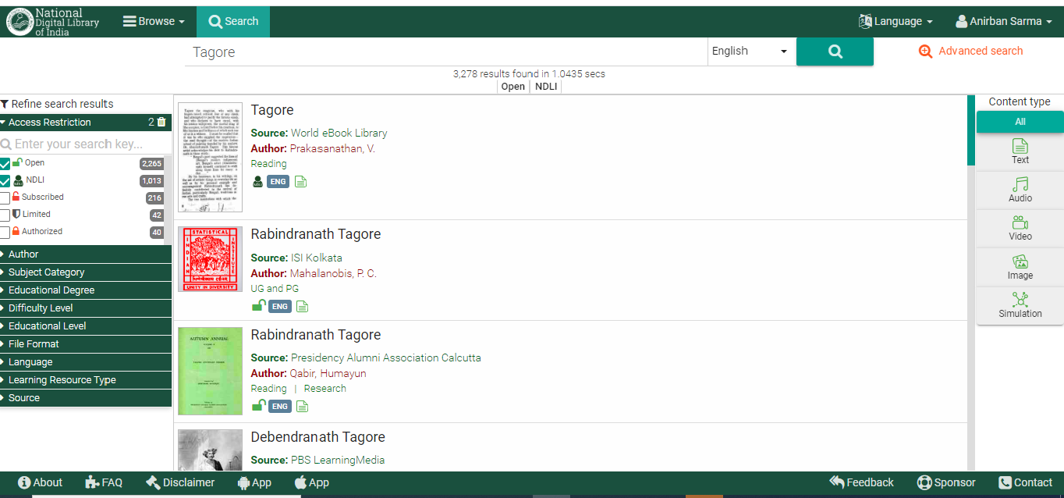
THE SEARCH PROCESS
REFINE YOUR SEARCH: By Access Restriction

Slide 21
Access Options
 | Open
 | Full-text available to all (Example: NCERT)
 | NDL Users
 | Full-text available through NDLI, not directly from Source (Example: South Asia Archive)
 | Limited Access
 | Part of text available but full-text requires authorization by Source authority (Example: IISER, Bhopal)
 | Subscribed
 | Full-text available from institutions that have subscribed to the Source (Example: Springer)
 | Restricted
 | Full-text access requires authorization by Source authority and separate login to the Source (Example: IIT Jodhpur)

Slide 22
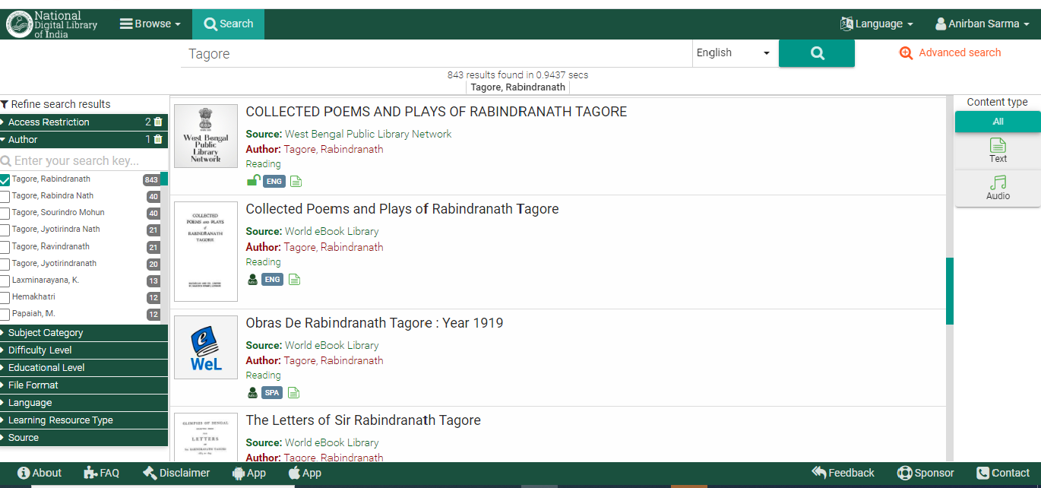
REFINE SEARCH:
By Author and Content-Type

Slide 23
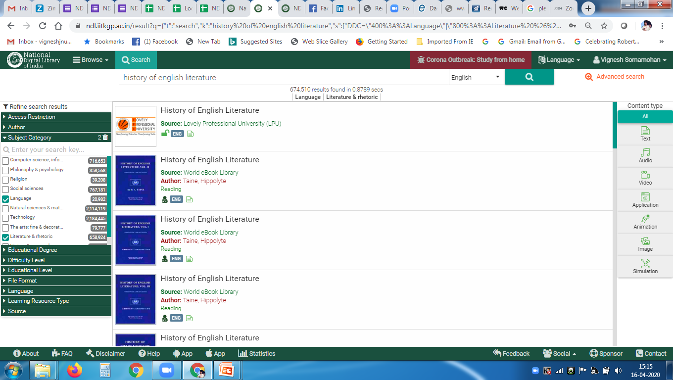
REFINE SEARCH:
By Subject Category

Slide 24
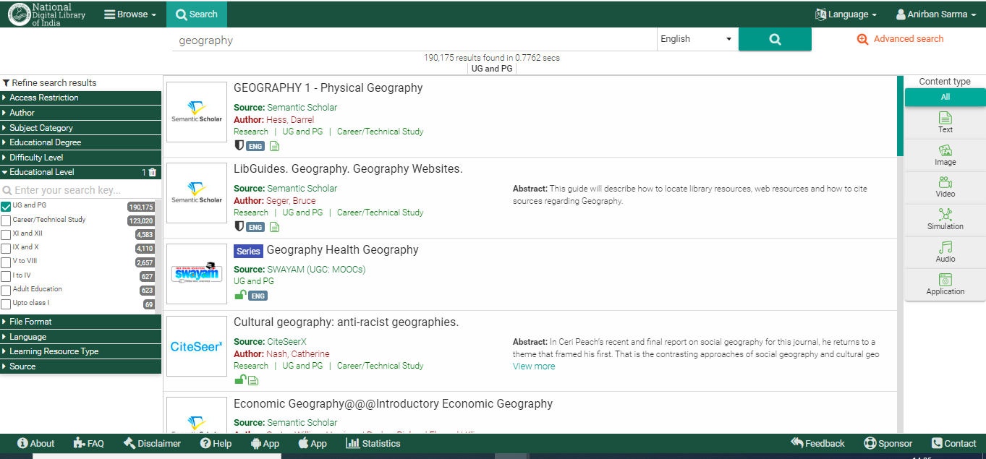
REFINE SEARCH:
By Educational Level

Slide 25
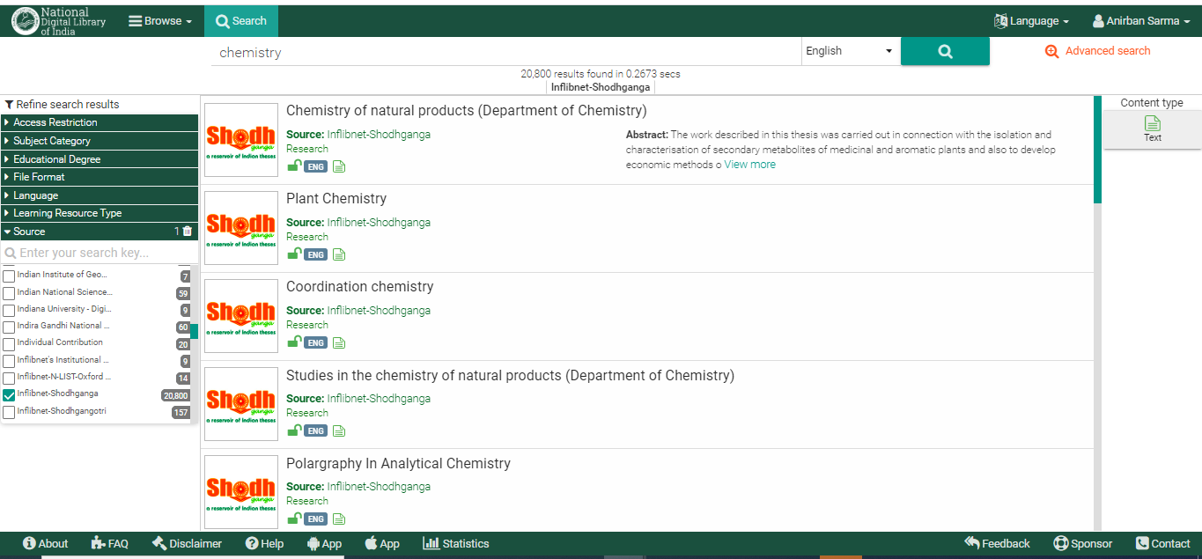
REFINE SEARCH:
By Source

Slide 26
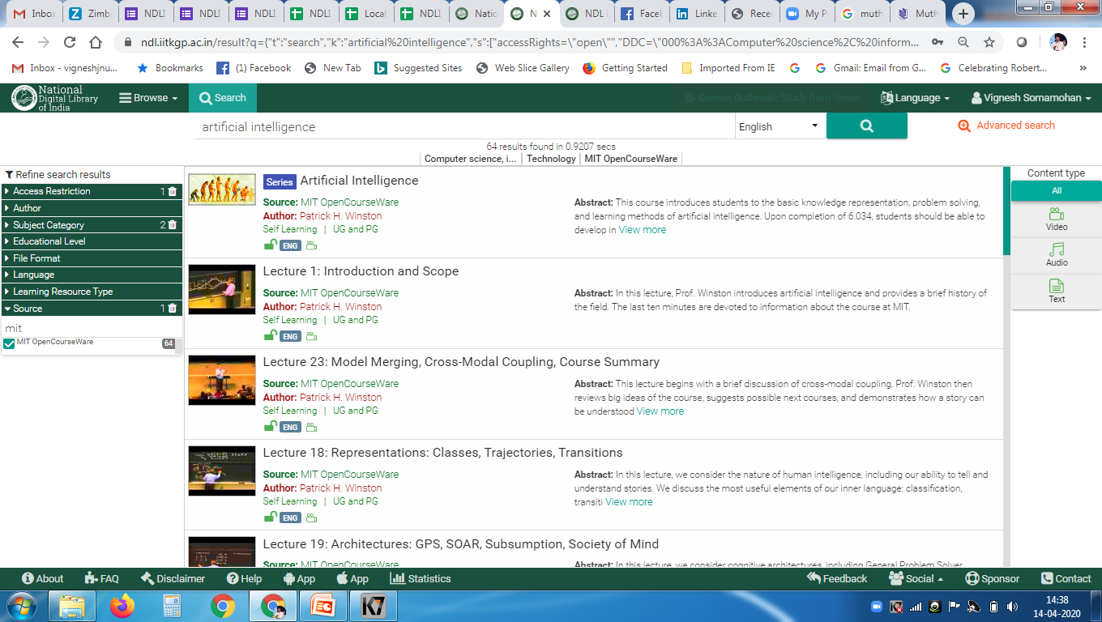
REFINE SEARCH (Comb.1):
By Subject Category, Access Restriction and Source

Slide 27
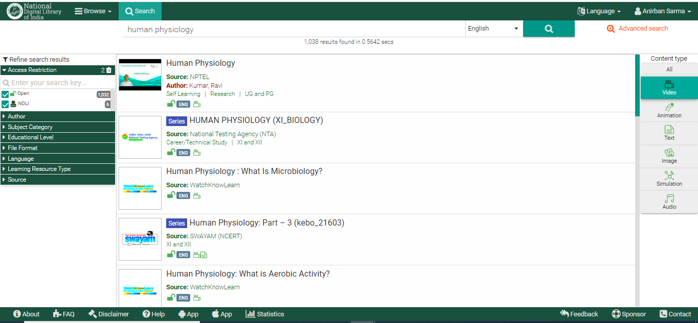
REFINE SEARCH (Comb. 2):
By Access Restriction & Content Type

Slide 28
RECAP: Filter Options 1

Slide 29
RECAP: Filter Options 2

Slide 30
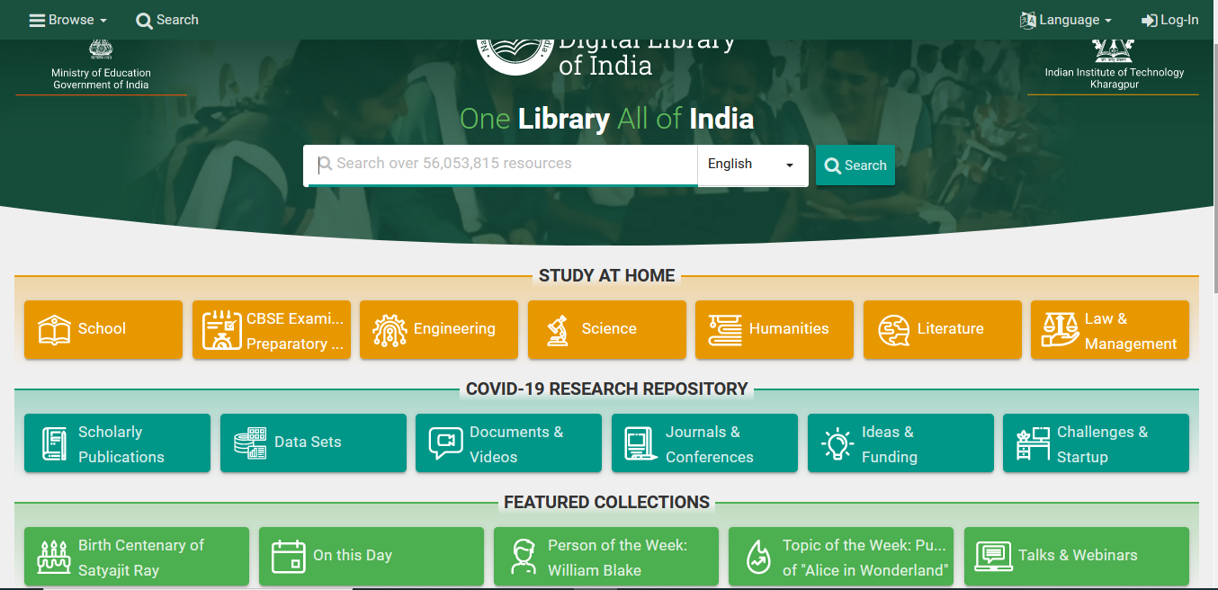
COVID-19 Research
Resources Repository
The repository contains collections on Scholarly Publications, Data Sets, Documents and Videos, Journals and Conferences, Ideas and Funding and Challenges and Startup covering all aspects of the COVID-19 research

Slide 31
NDLI’s Support for NEP 2020
Enhance online accessibility of library books and further broad basing of digital libraries. (Cl 21.9, p. 52)
Content Repository
Search and Browse
Repository of content - coursework, Learning Games & Simulations, AR & VR (Cl 24.4 (d), p. 59)
NROC (OU / DU)
Access to downloadable and printable versions of all textbooks (Cl. 4.32, p. 17)
Progress of child in project-based and inquiry-based learning, quizzes, role plays, … (Cl. 4.35, p. 17)
Topic-centered & Project-based Clubs (Cl. 4.44, p. 19), Activities by students, helped by faculty (Cl. 12.3, p. 39)
Olympiads and competitions in various subjects across the country (Cl. 4.45, p. 19)
Collections
School, Colleges, PG
Competitive Examination JEE, NEET, UPSC
Indian Knowledge Systems - tribal knowledge and indigenous & traditional ways of learning (Cl. 4.27/4.29, p. 16)
Conservation of our heritage as well as to India’s tourism industry. (Cl 22.13, p. 55)
The preservation and promotion of India ’s cultural wealth (Cl 22.1, p. 53)
Search Research
All languages in India, and their associated arts and culture to be documented (Cl 22.19, p. 56)
National Licensing
Smart classrooms, digital pedagogy & enriched teaching-learning process with online resources (Cl. 4.46, p. 20)
Technological interventions in teaching-learning & evaluation to enhance educational access (Cl 23.5, p. 57)
Educational Software and Contents (Cl. 23.6, p. 57)
NDLI Club: Competitions, Peer Study, Coaching
Adult Learning - apps, online courses, TV channels, online books, and ICT-equipped libraries (Cl 21.10, p. 52)
Digital Heritage
Classrooms with Appropriate Technology, Flexible Curriculum &, Assessment & Certification (Cl. 6.13, p. 27)
Multi-linguality
Contents, UI & Search
Equitable and Inclusive Education: Learning for All (Cl. 6, p. 24), Equity and Inclusion in HE (Cl. 14, p. 41)
Enabling mechanisms for CWSN or Divyang (Cl. 6.2.5, p. 25), RPWD Act 2016 & NEP 2020 (Cl. 6.10. p. 26)
Disability-friendly School (Cl. 6.11, p. 26), Regular or Special Schooling: Home-based Education (Cl. 6.12. p. 27)
Pedagogy Research
Appropriate Pedagogy and Teacher Education (Cl. 6.14, p. 27)
Disability Knowledge

Slide 32
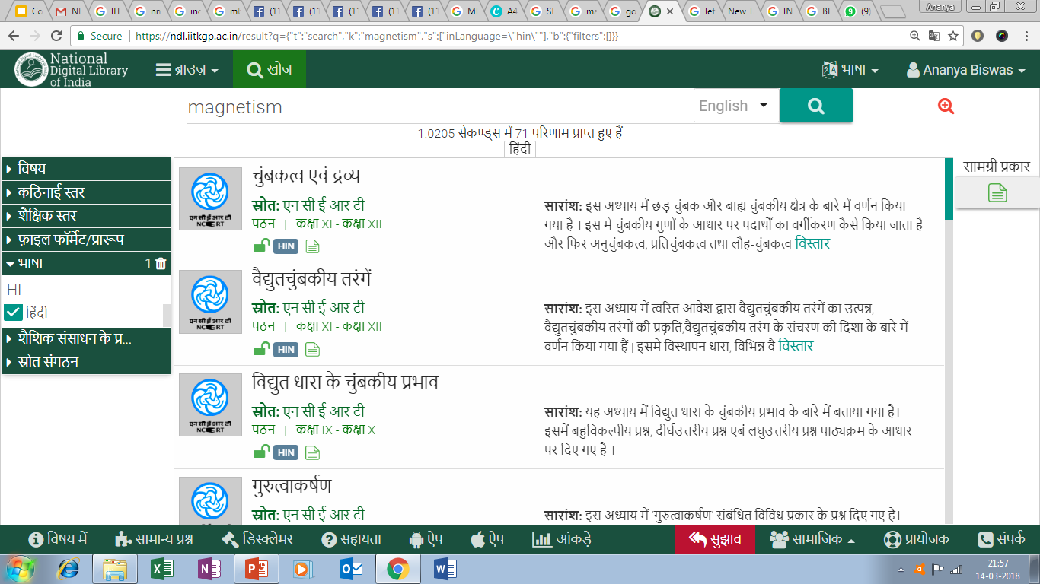
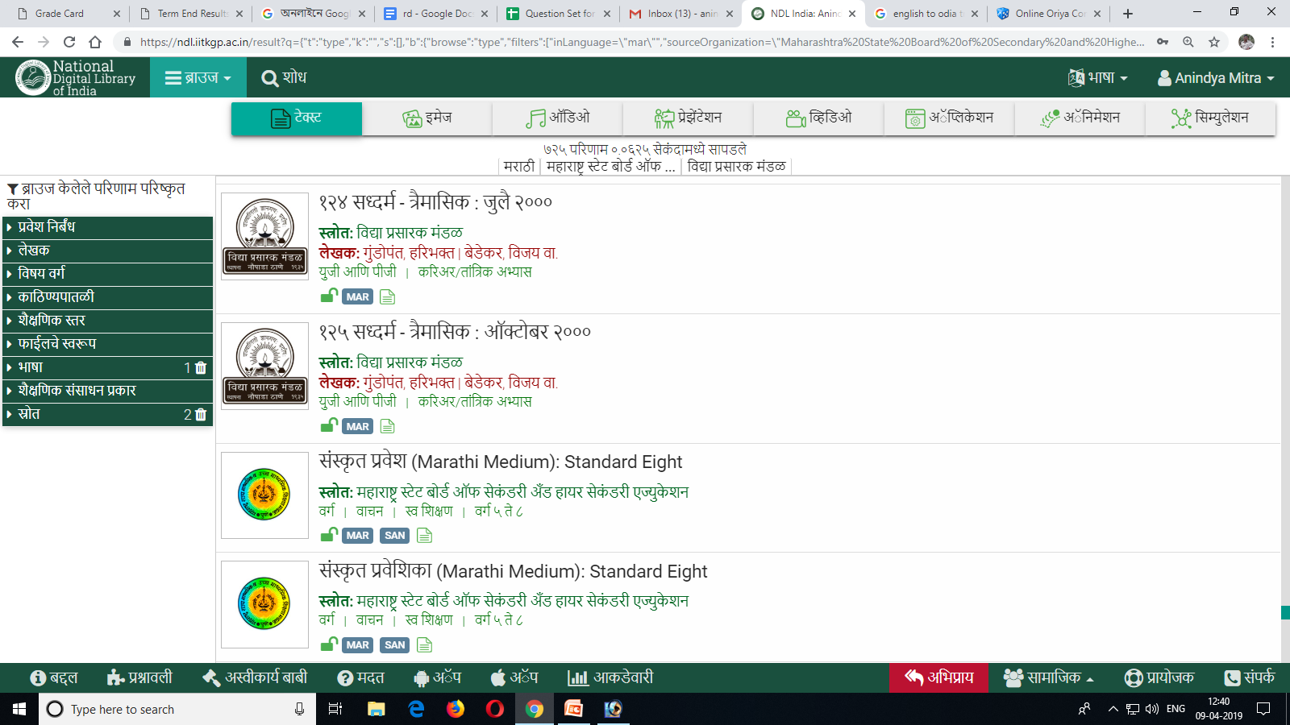
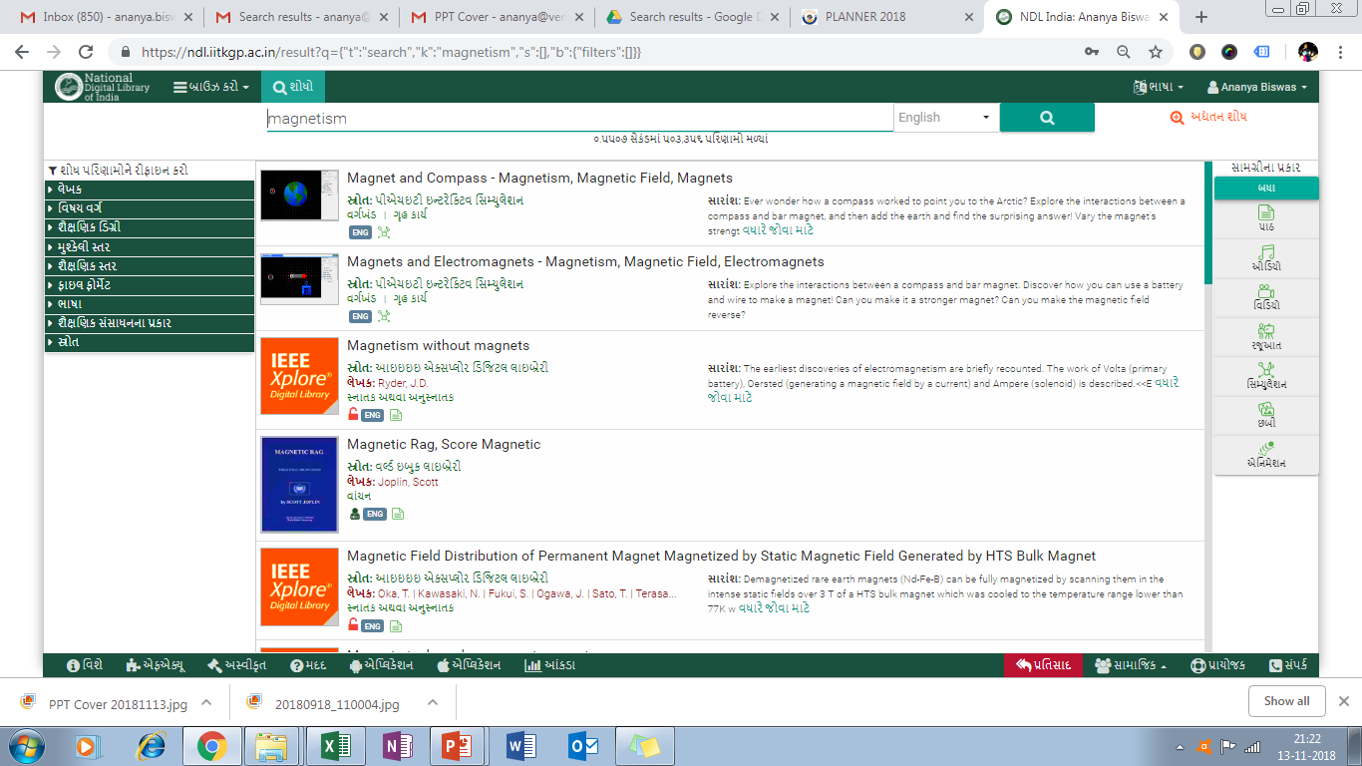
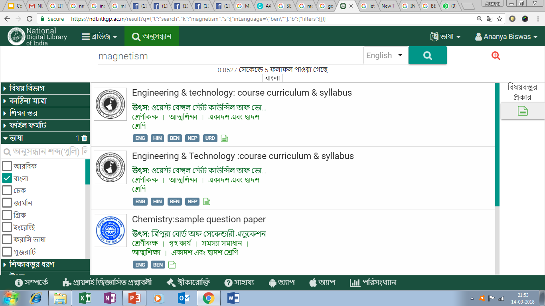
User Interface
Available in English and 10 most widely used Indian languages
English
Hindi Bengali Telugu (తెలుగు)
Tamil (தமிழ்)
Marathi Gujarati `Kannada (ಕನ್ನಡ)
Malayalam (മലയാളം)
Odiya (ଓଡିଆ)
Assamese (অসমীয়া)
(हिंदी)
(বাংলা)
NDLI HINDI
NDLI MARATHI
(मराठी)
(ગુજરાતી)
NDLI BENGALI
NDLI GUJRATI

Slide 33
JEE Main: From 2021 to 2014 JEE Advanced: From 2020 to 2007 NEET: From 2022 to 2019
JEE Main and JEE Advanced & NEET question papers and solutions: Conducting mock tests for JEE main and JEE advance
Competitive examination solutions like UPSC, SSC, etc. are available for how many years from 2022 to back
SSC CGL (TIER I Question + Solution): 2021 (05 SETs); 2017 (20 SETs)
SSC CHSL (TIER I Question + Solution): 2021 (10 SETs); 2011 (01 SET); 2010 (03 SETs); 2009 (01 SET); 2008 (01 SET).
UPSC (CDS I and CDS II Question + Solution): 2022
UPSC (CDS I and CDS II Questions only): From 2016 to 2009.
IBPS Clerk Prelims: 2021 (03 SETs); 2020 (07 SETs); 2018 (03 SETs); 2017 (03 SETs).
IBPS Clerk Mains: 2021 and 2020
IBPS PO Prelims: 2021 (03 SETs); 2020 (06 SETs); 2018 (03 SETs); 2017 (03 SETs).
IBPS PO Mains: 2021
RRB Group D: 2018 (10 SETs)
RRB ALP: 2018 (10 SETs)
RRB NTPC: 2015 (09 SETs)
SSC
UPSC
IBPS
RRB

Slide 34
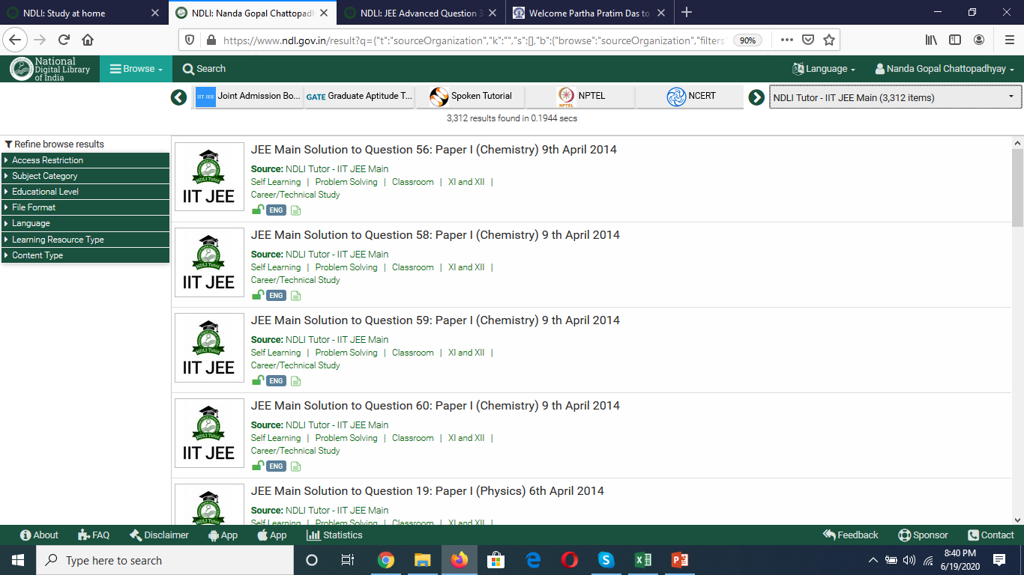
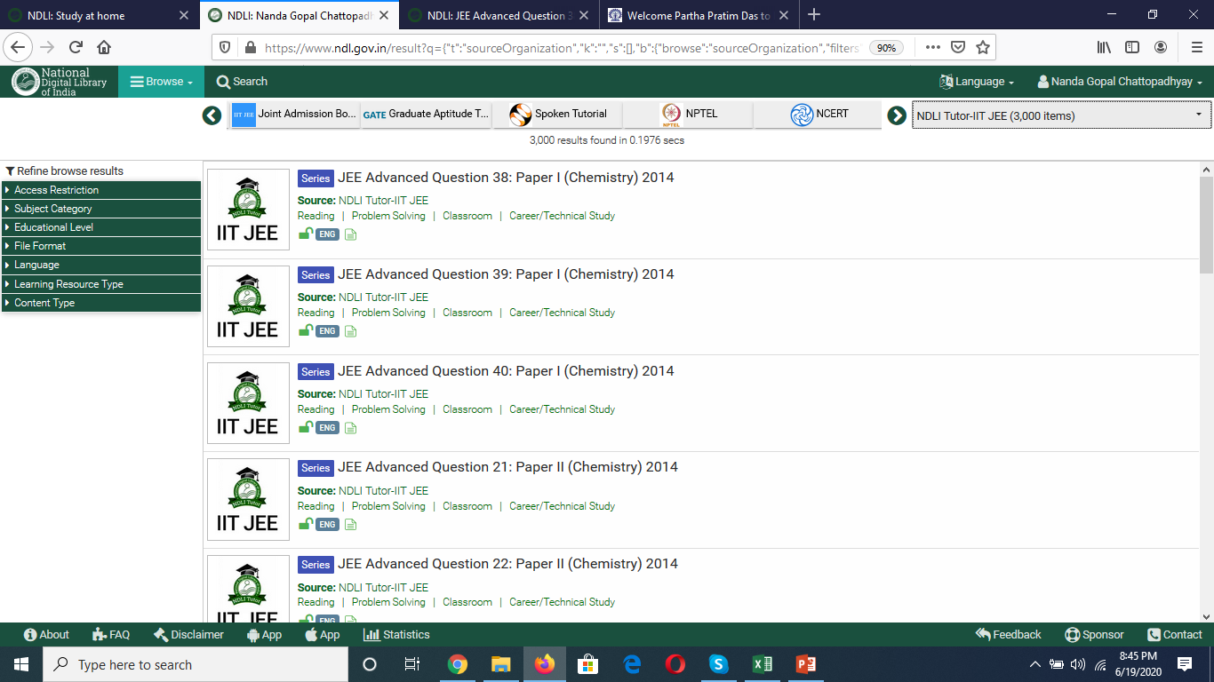
NDLI Tutor
JEE Main, JEE Advanced & NEET Questions & Solutions
JEE Main
JEE Advanced
Notes:
https://www.ndl.gov.in/homestudy/school

Slide 35
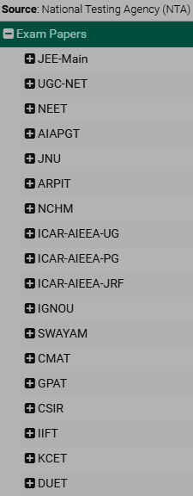
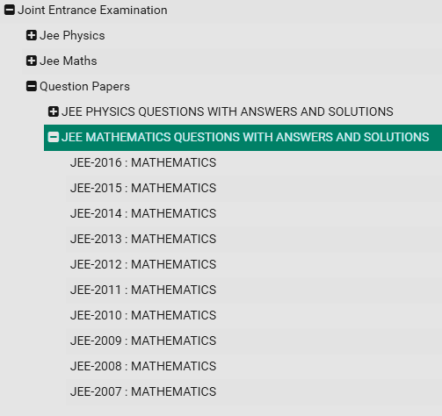
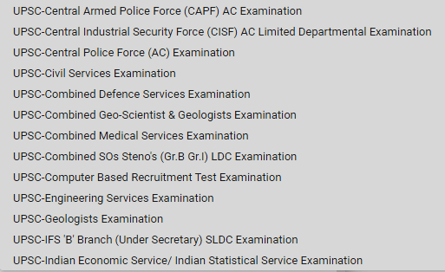
NDLI Contents: Competitive Exam Aspirants
Exam Papers of several competitive examinations

Slide 36
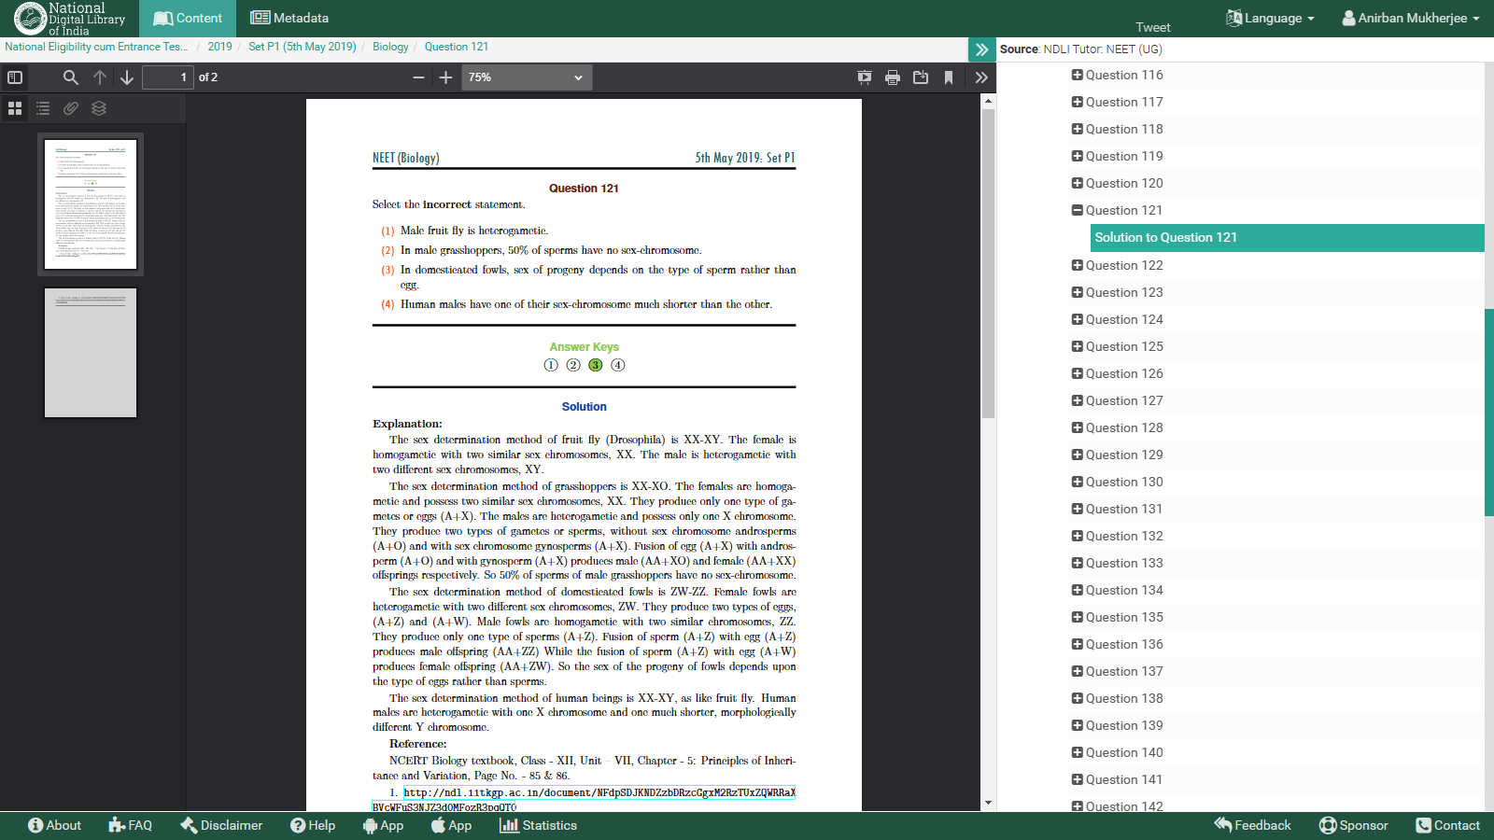
NEET (Biology) 2019 : Solution (Sample)
Solutions are written in detail, explaining all the given options, along with figures and reference readings.

Slide 37
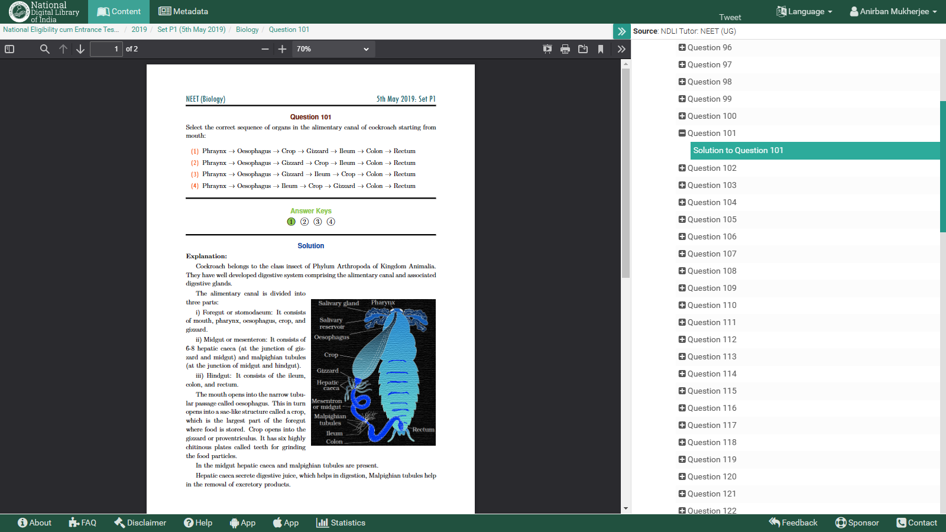
NEET (Biology) 2019 : Solution (Sample)
Solutions are written in detail, explaining all the given options, along with figures and reference readings.

Slide 38
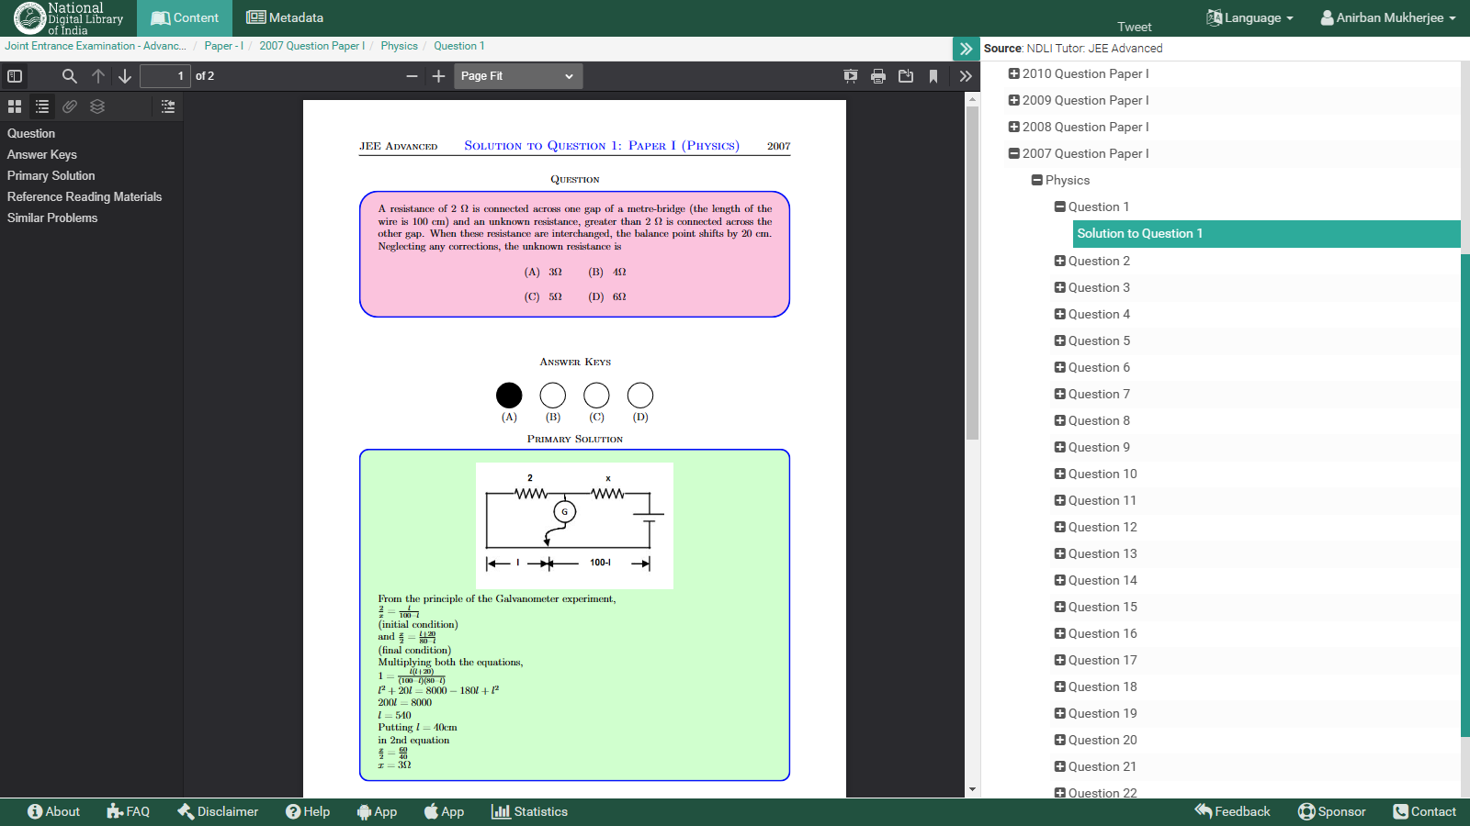
JEE Advanced (Physics) 2007 : Solution (Sample)
Solutions are written in detail, explaining all the given options, along with figures, reference readings, and similar problems.

Slide 39
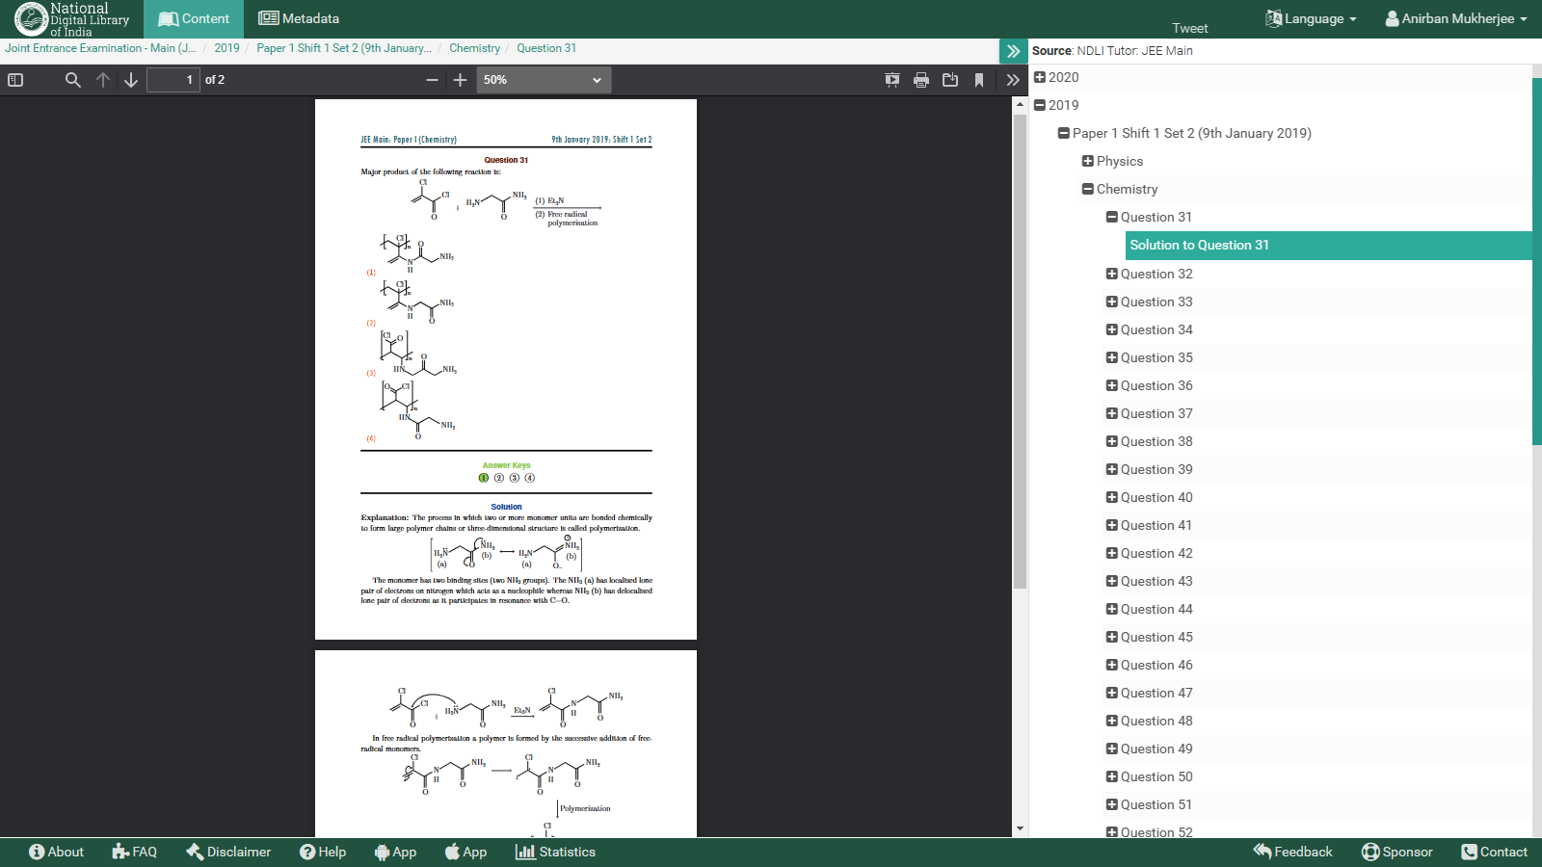
JEE Main (Chemistry) 2019 : Solution (Sample)
Solutions are written in detail, explaining all the given options, along with figures, and reference readings.

Slide 40
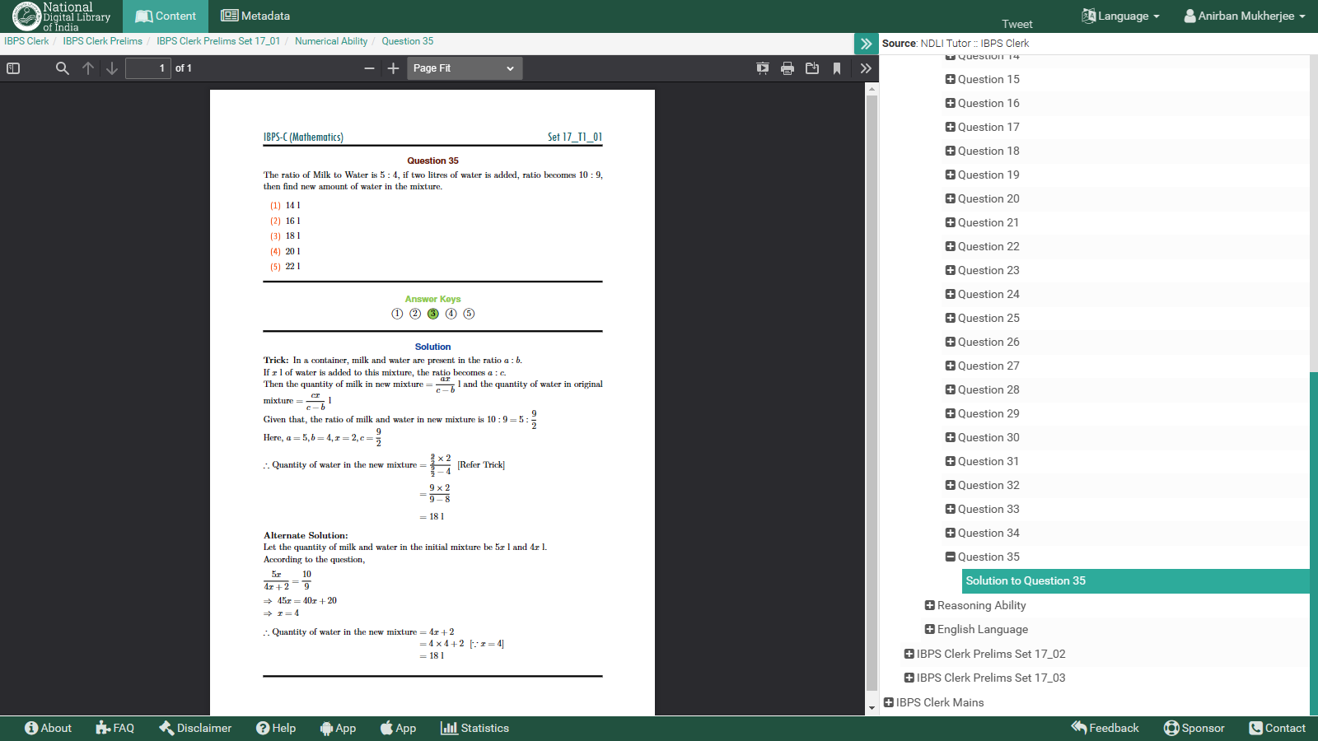
IBPS Clerk (Numerical Ability) 2017: Solution (Sample)
Solutions are written in detail, explaining all the given options, along with facts and figures.

Slide 41
NDLI Club and Objectives
1
2
3
An initiative to promote the culture of reading and learning using NDLI’s vast resources.
NDLI Club is an online platform for conducting learning-oriented activities.
Students enhance their core competence, sharpen their skills & their personality traits

Slide 42
NDLI Club Benefit to Institutes
Create a vibrant environment where students can achieve academic excellence as well as shape their personal interests and hobbies.
Students benefit immensely from vast online free resources in NDLI.
Activity-based learning is recommended in NEP 2020.
Club registration and promotion of NDLI is mandated by AICTE and helps in improving NIRF ranking.

Slide 43
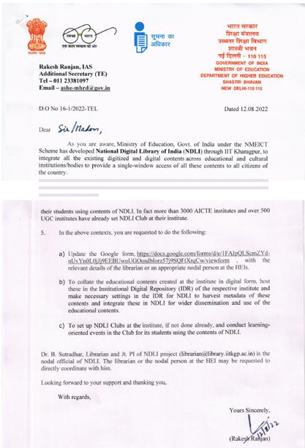
NDLI - Clubs & IDRs
MoE issued letters to all CFTIs to form NDLI Club & IDRs
AICTE & CBSE issued letters to all affiliated Colleges and Schools to form NDLI Club
Total Clubs: 4800+ (adding 1500 clubs per year)
Established 153 clubs in remote areas like NE, Andaman & Nicobar Island, and Ladakh to support the dissemination of Education.
150+ IDRs are integrated & supported

Slide 44
Collaborations

Slide 45
Recent Initiatives
Integrating NDLI e-contents with SWAYAM MOOCs
Collaboration with Educational Entrepreneurs to integrate contents & services
- Concept Note shared with MoE
Disability Knowledge Portal called DEEPAK (Disability Education and Engagement Portal for Access to Knowledge) (http://disability.ndl.gov.in/)
- Comprehensive platform for all information and resources regarding disabilities in India and around the world
Copyright Guide for Indian Libraries
- English version launched a few months ago
- Translated versions in Hindi, Marathi, Gujarati, Tamil, Malayalam, Bengali & Assamese almost ready to Launch

Slide 46
Free/Open-Source Tools
GROBID

Slide 47
International Partnership & Dialogue
Intergovernmental Bodies, Foundations, Archives
Universities, National Libraries, UGCs
Bhutan
Nepal
Maldives
National Library of Maldives
Tribhuvan
University
Bangladesh
Sri Lanka

Slide 48
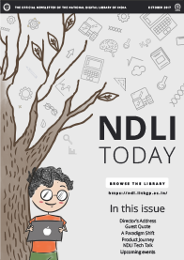
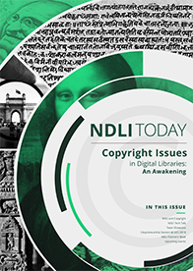
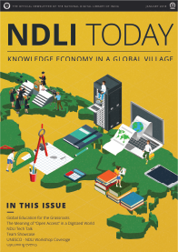
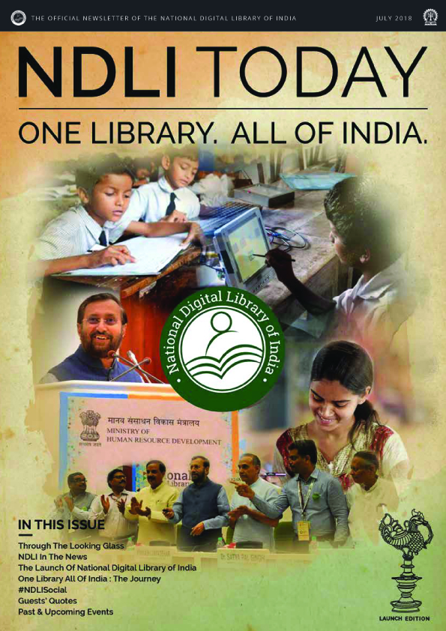
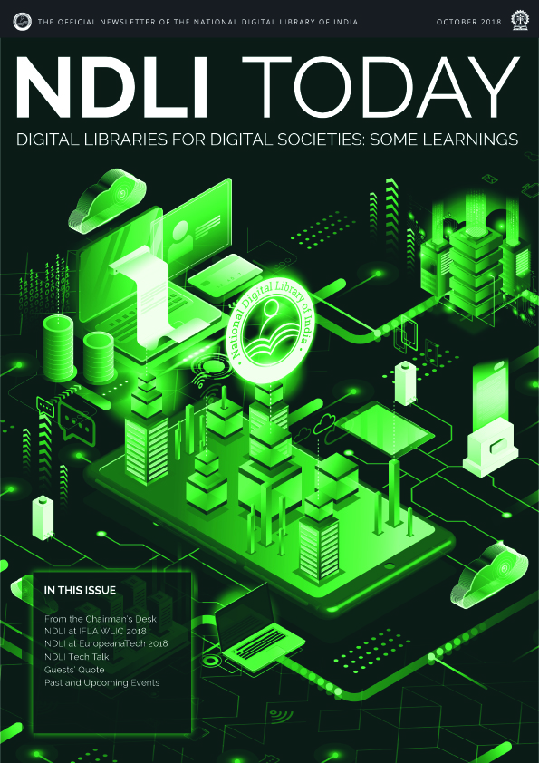
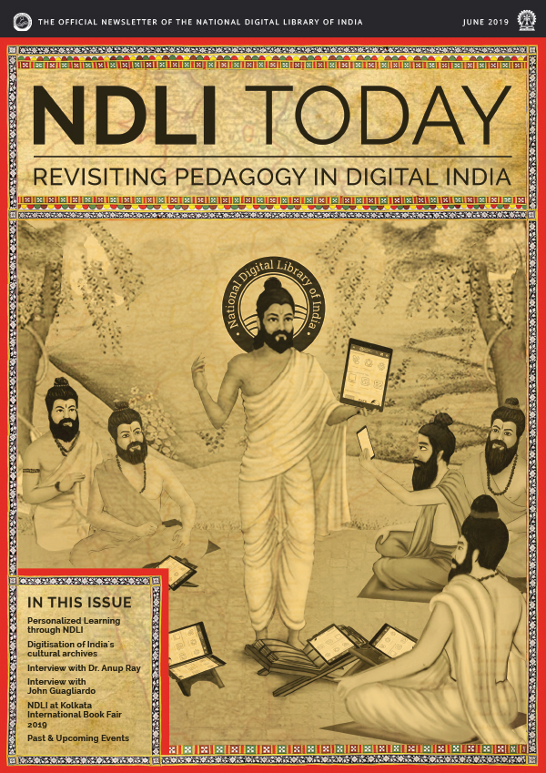
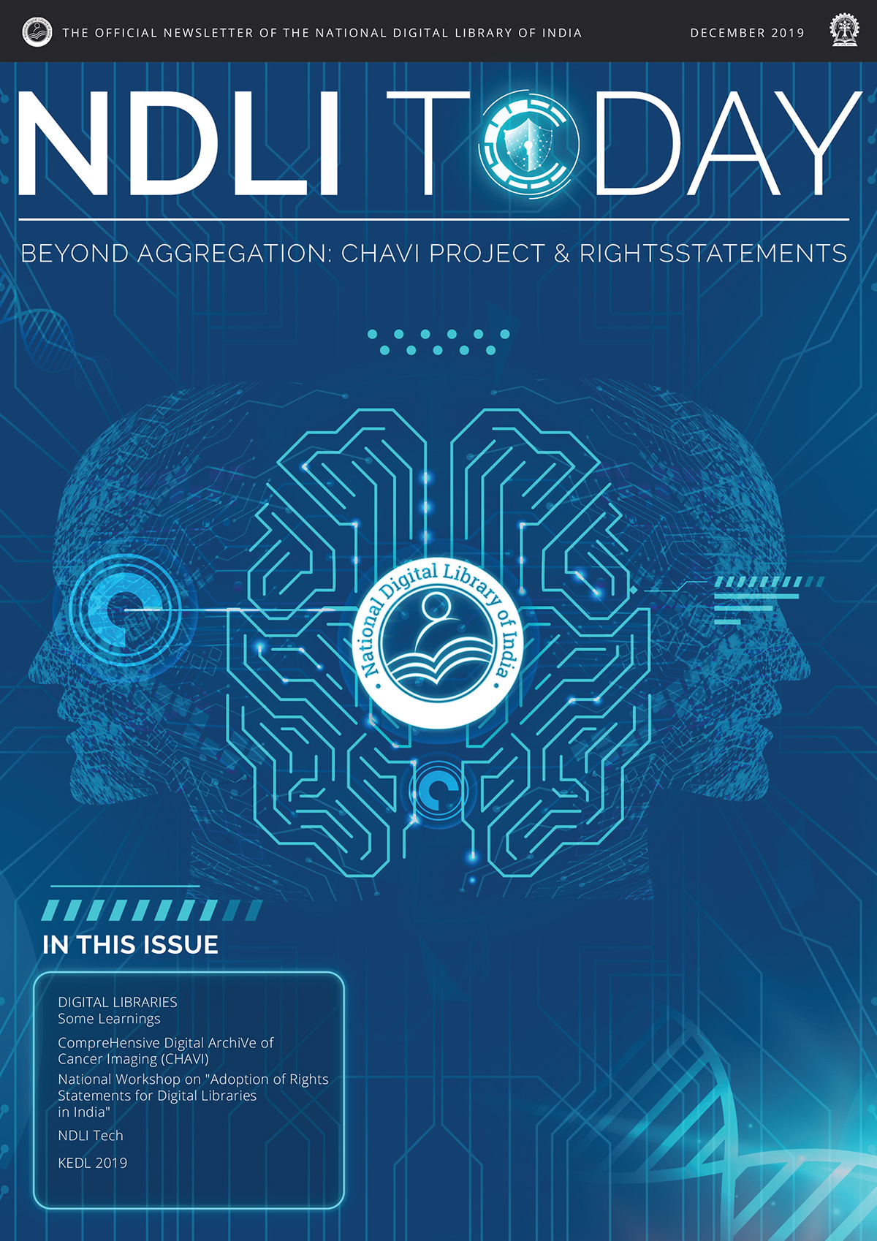
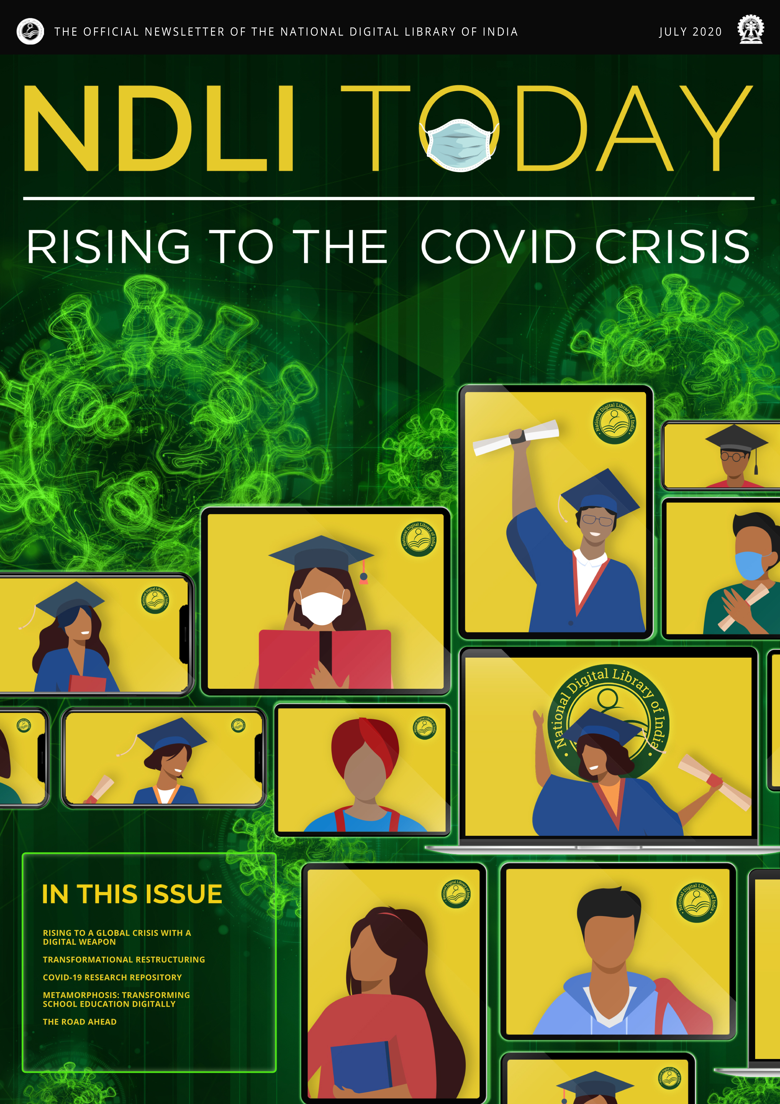
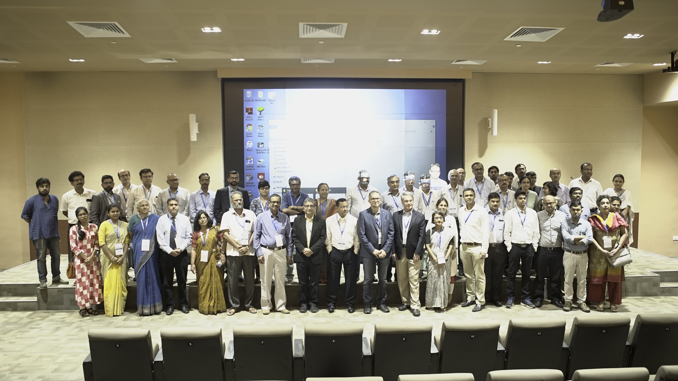
Outreach and Promotion
Social Media
NDLI Regional Centers
North East: IIT Guwahati
South: Anna Centenary Library, Chennai,
Dept of School Education, Govt. of TN
NDLI Collateral
Newsletter, Calendar, Brochure, Badge, …
NDLI Project Website (https://ndlproject.iitkgp.ac.in/)
NDLI project information dissemination
Browse the Library
Knowledge Economy
in Global Village
Copyright Issues
in Digital Libraries
Official Launch of NDLI
Oct, 2017
Jan, 2018
Apr, 2018
Jul, 2018
Medical Data Bank Workshop @ TMC
Digital Libraries for
Digital Societies
Revisiting Pedagogy
in Digital India
CHAVI Project and
Rightsstatements
Rising to the
COVID Crisis
Oct, 2018
Jun, 2019
Dec, 2019
Jul, 2020
Newsletters
Int’l Symposium
KEDL 2017: UNESCO
KEDL 2019: IIT Delhi
ICDL 2016, 2019: TERI
Pan-India IDR WS
31 in 25 states
1980 Lib. Sc. / IT trained
Pan-India User WS
450 Workshops
Physical as well as online
Special Meets and Participations
NDLI Partners Meet
National Copyright & Rights Statements Workshop
Presented in 100+ Nat’l & Int’l Events/Forums
Workshops, Events and Forums

Slide 49
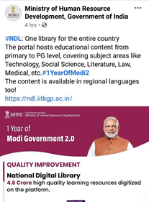
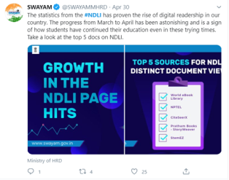
Glimpses of Endorsements
Twitter: 20th June 2020
Twitter: 5th June 2020
NDLI – A leading contributor to Global COVID Education Response: UNESCO
“The Indian diaspora as well as the rest of the world can now avail knowledge from this multilingual, multi subject, multimedia digital repository [NDLI] that any individual learner or a lifelong learner can avail”
Sundaram " Sundy" Srinivasan, President - PanIIT USA, Sept. 29, 2021

Slide 50
Awards Received
WINNER: World Summit Award 2021 in ‘Learning & Education’ category
WINNER: Elets Award of Digital Excellence 2020 in ‘Digital Innovation’ category
WINNER: SM4E Award 2020-21 in ‘Innovation @ COVID-19’ category
WINNER: Gems of Digital India 2019 for excellence in eGovernance
WINNER: Open Resilience Award 2020 for leadership in Open Education during COVID-19
WINNER: _{m}Billion^{th} South Asia Award 2017 for Android mobile app in ‘Learning & Education’ category

Slide 51
Way Forward
New CMS & Club Portal
ISO Implementation
In Progress
National Digital University
Under Implementation
To Support
Under Implementation
InterLibrary Loan (ILL)
Under
Preparation
Under Discussion
UI for Children & Adolescents
Under Preparation
Cloud Service for Library Automation
Competitive Exam Mock Test

Slide 52
Challenges
Inadequacy of Skilled Manpower.
Strengthening NDLI club-related activities in order to outreach to all corners of the country and to revamp club Portal.
Management & maintenance of huge setup of IT hardware, peripherals & softwares like 85 physical servers distributed in 2 data-centers.
Limited Govt. initiatives for higher and better promotion of NDLI.
Struggling to provide Good number of Text and Reference Books due to Copyright Issues appending with Publishers.
Gradual limitation in availability of High Volume OER Sources for integration.

Slide 53
National Digital Library of India
The only thing that you absolutely have to know (may use Google, though), is the URL of NDLI:
https://www.ndl.gov.in/
Rest you find in NDLI
Thank you

